Slide 1
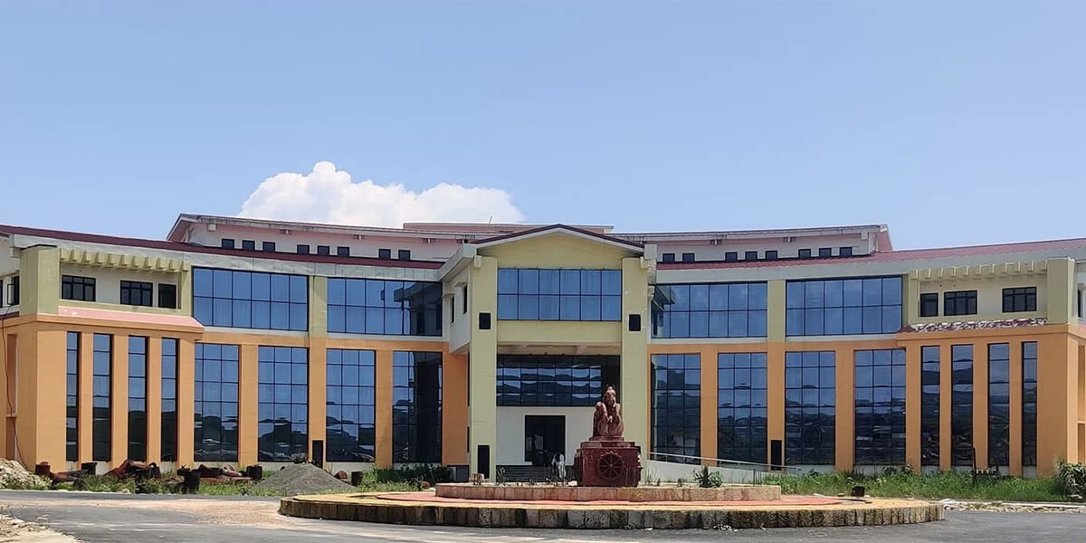





2026 IEEE North-East India International Energy Conversion Conference and Exhibition
Paper ID
TITLE OF THE PAPER [24 Font]
XX
All Authors’ Name [14 Font]
Name of the Presenter [20 Font]
Email of the Presenter [16 Font]
Affiliation: National Institute of Technology Meghalaya
The PPT should not be more than 10 slides
12th - 14th June 2026 | NIT Meghalaya, Sohra, India
Date:
NE-IECCE 2026| NIT Meghalaya| June 12-14, 2026
Page:

Slide 2
Motivation:
Date:
NE-IECCE 2026| NIT Meghalaya| June 12-14, 2026
Page:

Slide 3
Objective:
Date:
NE-IECCE 2026| NIT Meghalaya| June 12-14, 2026
Page:

Slide 4
Analysis:
Date:
NE-IECCE 2026| NIT Meghalaya| June 12-14, 2026
Page:

Slide 5
Key Result:
Date:
NE-IECCE 2026| NIT Meghalaya| June 12-14, 2026
Page:

Slide 6
Conclusion:
Date:
NE-IECCE 2026| NIT Meghalaya| June 12-14, 2026
Page:

Slide 7
2026 IEEE North-East India International Energy Conversion Conference and Exhibition
12th - 14th June 2026 | NIT Meghalaya, Sohra, India
Paper ID XX
Thank You
Question Please!!!!
Date:
NE-IECCE 2026| NIT Meghalaya| June 12-14, 2026
Page:

